Slide 1
Helm The package manager for Kubernetes
From zero to hero
Daniel Hasselwander

Slide 2


Goals for this session
What is helm
Why it is useful
Alternatives
Concepts from Helm

Slide 3


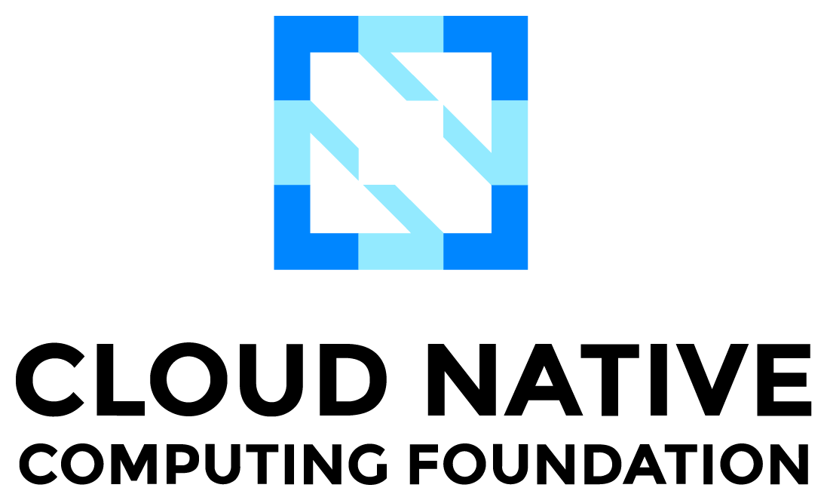


Helm - Profile
Package Manager for k8s
Config-Files YAML
CNCF
Written in Go
Notes:
Package Manager for Kubernetes like Package manager Npm, nuget etc.
Maintaned by Helm Community
Consists of 2 parts Client Software and Library

Slide 4
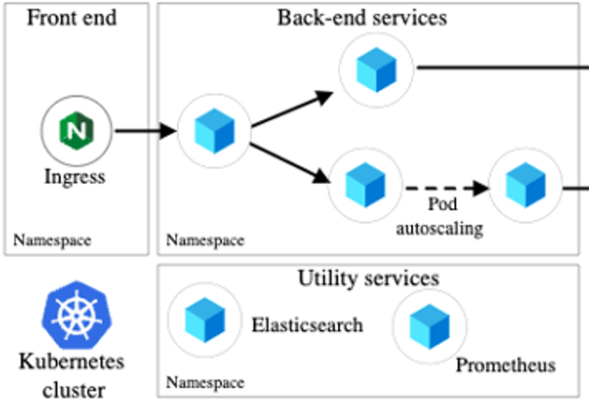
Kubernetes application
Notes:
Deploy a product with a lot of ressources can be make pain
Create a release ?

Slide 5
Kubernetes application
Kubernetes Ressourcen
2 Namespaces
1 Ingress
4 Deployments
1 HPA
Notes:
Deploy a product with a lot of ressources can be make pain
Create a release ?

Slide 6

How we can manage this ?

Slide 7
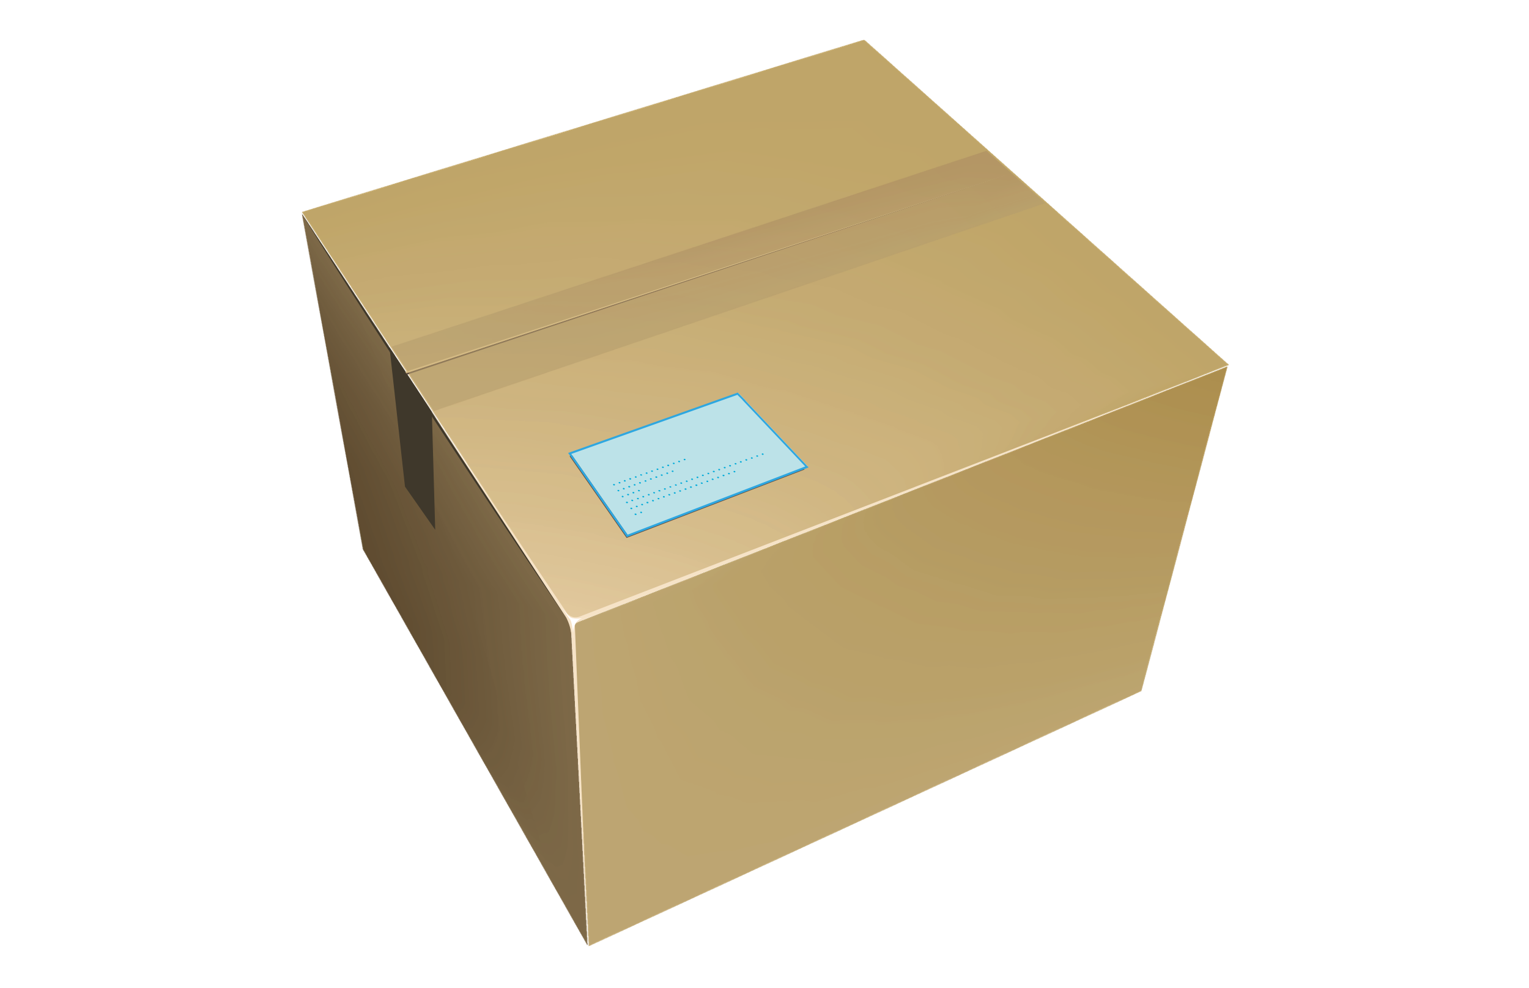
Kubernetes application
Helm
App
Notes:
Deploy a product with a lot of ressources can be make pain
Create a release ?

Slide 8

Why you should use Helm
Manage K8s Complexity
Simple Sharing
Test your App
Easy Rollbacks
Notes:
Single Source of Truth
Which Components you need
Simple Sharing Applications only Install with Helm
It is a Share medium for our applications
Rollbacks to old release version are really easy

Slide 9

Do you know alternatives to deploy applications in k8s like modules or packages ?
Notes:
Deploy a product with a lot of ressources can be make pain
Create a release ?

Slide 10

Microsoft Bicep
Notes:
Nur weil man kann muss man das nicht machen. Terraform kann keine Tests. Releases Rollback

Slide 11
Helm – Alternatives – My Opinion
Helm is best practice for k8s packages
Helm can test your App works
Use Terraform outside your cluster and helm inside
Notes:
Helm and Logo
Package Manager for Kubernetes like Package manager Npm, nuget etc.
Maintaned by Helm Community
2 Parts Client Software and Library
The Helm Library provides the logic for executing all Helm operations. It interfaces with the Kubernetes API server and provides the following capability:
Combining a chart and configuration to build a release
Installing charts into Kubernetes, and providing the subsequent release object
Upgrading and uninstalling charts by interacting with Kubernetes
The standalone Helm library encapsulates the Helm logic so that it can be leveraged by different clients.
Client command-line client for end users
Local chart development
Managing repositories
Managing releases
Interfacing with the Helm library
Sending charts to be installed
Requesting upgrading or uninstalling of existing releases

Slide 12
Work with Helm – Processes
Development
Deployment/Interaction with K8s
Notes:
Helm and Logo
Package Manager for Kubernetes like Package manager Npm, nuget etc.
Maintaned by Helm Community
2 Parts Client Software and Library
The Helm Library provides the logic for executing all Helm operations. It interfaces with the Kubernetes API server and provides the following capability:
Combining a chart and configuration to build a release
Installing charts into Kubernetes, and providing the subsequent release object
Upgrading and uninstalling charts by interacting with Kubernetes
The standalone Helm library encapsulates the Helm logic so that it can be leveraged by different clients.
Client command-line client for end users
Local chart development
Managing repositories
Managing releases
Interfacing with the Helm library
Sending charts to be installed
Requesting upgrading or uninstalling of existing releases

Slide 13
Work with Helm – Processes
Development
Deployment/Interaction with K8s
Notes:
Helm and Logo
Package Manager for Kubernetes like Package manager Npm, nuget etc.
Maintaned by Helm Community
2 Parts Client Software and Library
The Helm Library provides the logic for executing all Helm operations. It interfaces with the Kubernetes API server and provides the following capability:
Combining a chart and configuration to build a release
Installing charts into Kubernetes, and providing the subsequent release object
Upgrading and uninstalling charts by interacting with Kubernetes
The standalone Helm library encapsulates the Helm logic so that it can be leveraged by different clients.
Client command-line client for end users
Local chart development
Managing repositories
Managing releases
Interfacing with the Helm library
Sending charts to be installed
Requesting upgrading or uninstalling of existing releases

Slide 14
Helm – Development
Notes:
Client command-line client for end users
Local chart development
Managing repositories
Managing releases
Interfacing with the Helm library
Sending charts to be installed
Requesting upgrading or uninstalling of existing releases

Slide 15
Helm – Development
Chart
Helm CLI
Notes:
CLI chart = Templates Files
Local chart development
Managing repositories
Managing releases
Interfacing with the Helm library
Sending charts to be installed
Requesting upgrading or uninstalling of existing releases

Slide 16
Helm – Chart - Definition
Helm uses a packaging format called charts
A chart is a collection of files that describe a related set of Kubernetes resources
Comparable like a class in C# or Java
Notes:
CLI chart = Templates Files
Local chart development
Managing repositories
Managing releases
Interfacing with the Helm library
Sending charts to be installed
Requesting upgrading or uninstalling of existing releases

Slide 17
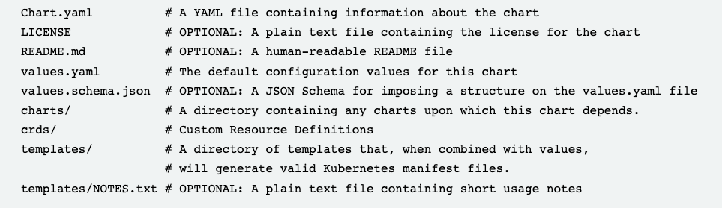
Helm – Chart – Folder Structure
Helm uses a packaging format called charts
Notes:
CLI chart = Templates Files
Local chart development
Managing repositories
Managing releases
Interfacing with the Helm library
Sending charts to be installed
Requesting upgrading or uninstalling of existing releases

Slide 18
Helm – Chart - Types
Application Chart
=
1 Application
Umbrella Chart
=
X Applications
Can also update the values of it´s subcharts
Library Chart
=
Contains Helper Code
Must be a dependency of a other chart
App
App
SQL-DB
Notes:
CLI chart = Templates Files
Local chart development
Managing repositories
Managing releases
Interfacing with the Helm library
Sending charts to be installed
Requesting upgrading or uninstalling of existing releases

Slide 19
Helm – Development
Chart
Helm CLI
Notes:
CLI chart = Templates Files
Local chart development
Managing repositories
Managing releases
Interfacing with the Helm library
Sending charts to be installed
Requesting upgrading or uninstalling of existing releases

Slide 20
Helm – Development
Chart
Repository
Helm CLI
Helm CLI
Notes:
CLI chart = Templates Files
Local chart development
Managing repositories
Managing releases
Interfacing with the Helm library
Sending charts to be installed
Requesting upgrading or uninstalling of existing releases

Slide 21
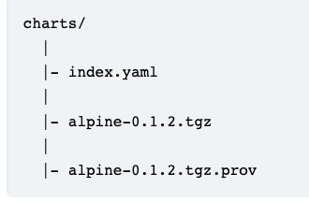
Helm – Repository
You do not need a repository
A chart repository is an HTTP server that houses an index.yaml file and optionally some packaged charts.
Distributed community Helm chart repository is located at Artifact Hub
Notes:
CLI chart = Templates Files
Local chart development
Managing repositories
Managing releases
Interfacing with the Helm library
Sending charts to be installed
Requesting upgrading or uninstalling of existing releases

Slide 22
Helm – Repository in OCI-Registries
Can use several container registry
A registry store zero or more helm repositories
Now it will be named OCI-Charts
Notes:
CLI chart = Templates Files
Local chart development
Managing repositories
Managing releases
Interfacing with the Helm library
Sending charts to be installed
Requesting upgrading or uninstalling of existing releases

Slide 23
Work with Helm – Process
Development
= CLI
Deployment/Interaction with K8s
Notes:
Helm and Logo
Package Manager for Kubernetes like Package manager Npm, nuget etc.
Maintaned by Helm Community
2 Parts Client Software and Library
The Helm Library provides the logic for executing all Helm operations. It interfaces with the Kubernetes API server and provides the following capability:
Combining a chart and configuration to build a release
Installing charts into Kubernetes, and providing the subsequent release object
Upgrading and uninstalling charts by interacting with Kubernetes
The standalone Helm library encapsulates the Helm logic so that it can be leveraged by different clients.
Client command-line client for end users
Local chart development
Managing repositories
Managing releases
Interfacing with the Helm library
Sending charts to be installed
Requesting upgrading or uninstalling of existing releases

Slide 24
Helm – Deployment
Repository
Helm CLI
Helm Library
Release
Kubernetes Cluster
K8s API
Helm Library
Notes:
The Helm Library provides the logic for executing all Helm operations. It interfaces with the Kubernetes API server and provides the following capability:
Combining a chart and configuration to build a release
Installing charts into Kubernetes, and providing the subsequent release object
Upgrading and uninstalling charts by interacting with Kubernetes
The standalone Helm library encapsulates the Helm logic so that it can be leveraged by different clients.
Interfacing with the Helm library
Sending charts to be installed
Requesting upgrading or uninstalling of existing releases

Slide 25
Helm – Release
Like a Object in C# or Java
What you really deploy
Notes:
CLI chart = Templates Files
Local chart development
Managing repositories
Managing releases
Interfacing with the Helm library
Sending charts to be installed
Requesting upgrading or uninstalling of existing releases

Slide 26
Work with Helm – Process
Development
= CLI
Deployment/Interaction with K8s
= Library
Notes:
Helm and Logo
Package Manager for Kubernetes like Package manager Npm, nuget etc.
Maintaned by Helm Community
2 Parts Client Software and Library
The Helm Library provides the logic for executing all Helm operations. It interfaces with the Kubernetes API server and provides the following capability:
Combining a chart and configuration to build a release
Installing charts into Kubernetes, and providing the subsequent release object
Upgrading and uninstalling charts by interacting with Kubernetes
The standalone Helm library encapsulates the Helm logic so that it can be leveraged by different clients.
Client command-line client for end users
Local chart development
Managing repositories
Managing releases
Interfacing with the Helm library
Sending charts to be installed
Requesting upgrading or uninstalling of existing releases

Slide 27
Work with Helm – Practice – Time
Notes:
Helm and Logo
Package Manager for Kubernetes like Package manager Npm, nuget etc.
Maintaned by Helm Community
2 Parts Client Software and Library
The Helm Library provides the logic for executing all Helm operations. It interfaces with the Kubernetes API server and provides the following capability:
Combining a chart and configuration to build a release
Installing charts into Kubernetes, and providing the subsequent release object
Upgrading and uninstalling charts by interacting with Kubernetes
The standalone Helm library encapsulates the Helm logic so that it can be leveraged by different clients.
Client command-line client for end users
Local chart development
Managing repositories
Managing releases
Interfacing with the Helm library
Sending charts to be installed
Requesting upgrading or uninstalling of existing releases

Slide 28
Go's New Brand - The Go Programming Language
Helm
Cloud Native Computing Foundation (cncf.io)
Microservices architecture on AKS - Azure Architecture Center | Microsoft Learn

